Slide 1


CHENNAI PROPERTY PRICE PREDICTION
CHENNAI PROPERTY PRICE PREDICITION
CHENNAI PROPERTY PRICE PREDICTION

Slide 2
TARGETED GROUPS
The model can be useful to
Buying party interested to purchase a property
Selling party to reason the price fixed on the property
Property brokers to refer the price trends

Slide 3
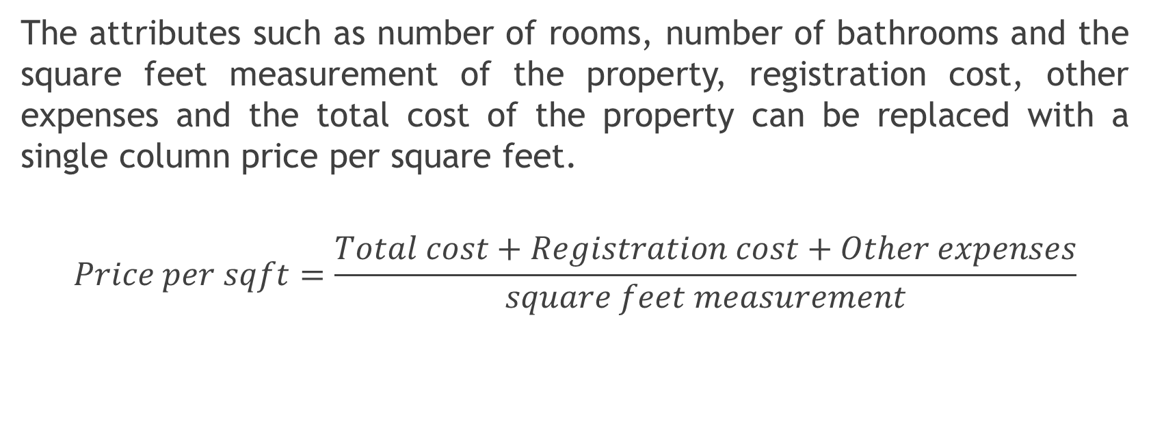
REDUCING THE NUMBER OF ATTRIBUTES
The attributes such as number of rooms, number of bathrooms and the square feet measurement of the property, registration cost, other expenses and the total cost of the property can be replaced with a single column price per square feet.
$$Price per sqft=\frac{Total cost+Registration cost+Other expenses}{square feet measurement}$$

Slide 4
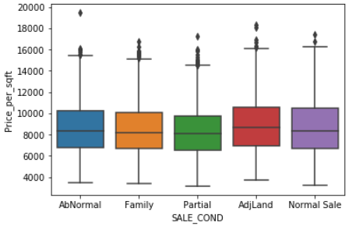
EXPLORATORY ANALYSIS INVOLVED
The box plot shown above is plotted for type of building vs Price per square feet. Significant overlap of the categories indicate this categorical variable is not a potential predictor

Slide 5
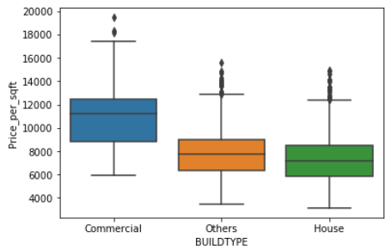
The box plot shown above is plotted for type of building vs Price per square feet. Significant overlap of the categories indicate this categorical variable is not a potential predictor

Slide 6
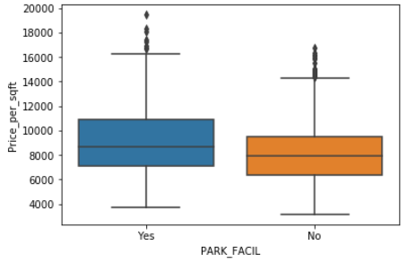
The box plot shown above is plotted for availability of park facility vs Price per square feet. This variable is a potential predictor

Slide 7
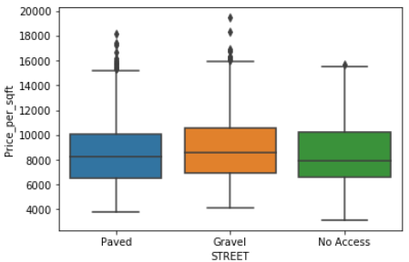
The box plot shown above is plotted for Type of street vs Price per square feet. Significant overlap of the categories indicate this categorical variable is not a potential predictor

Slide 8
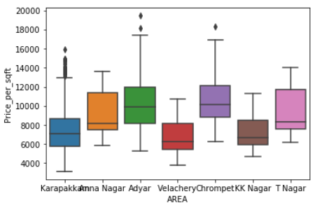
The box plot shown above is plotted for availability of area vs Price per square feet. This variable is the most important category.

Slide 9
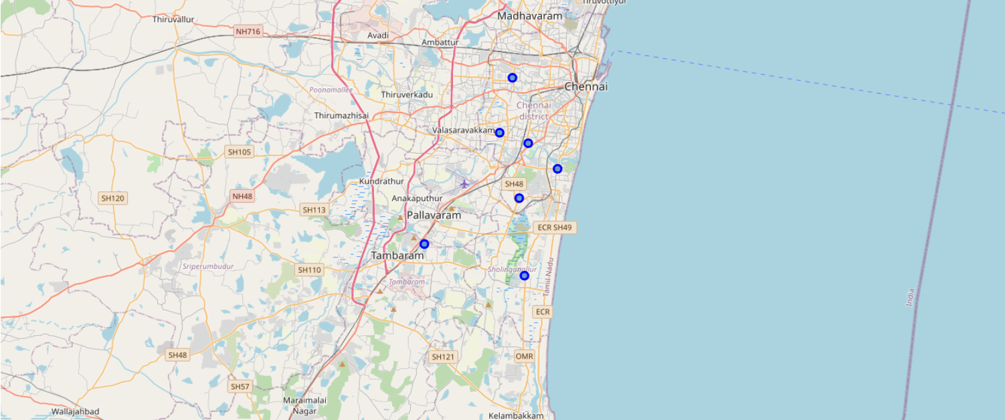
THE NEIGHBOURHOOD PLOTTED ON MAP

Slide 10
MULTIPLE LINEAR REGRESSION
The multiple linear regression model built is trained with the training data and the price per square feet of the test data is predicted

Slide 11
ADDITIONAL INSIGHTS
The house prices at Anna Nagar, Adyar and T Nagar are comparatively high compared to other neighbourhoods
Commercial properties are generally high priced than other properties

Slide 12
CONCLUSION
The model built and trained using the data set is capable of predicting the prices per square feet of the property given as input.
Model proves to be useful to three parties
Buyers
Sellers
Property brokers
This model with further improvements and increased precession is capable of potentially impacting the way the real estate business function

